Slide 1

SYNTACTIC PARSING

Slide 2
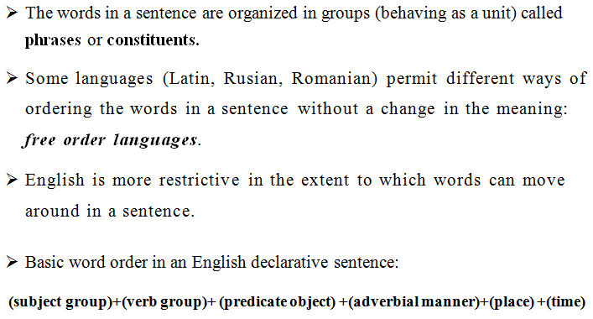
PHRASE STRUCTURE

Slide 3
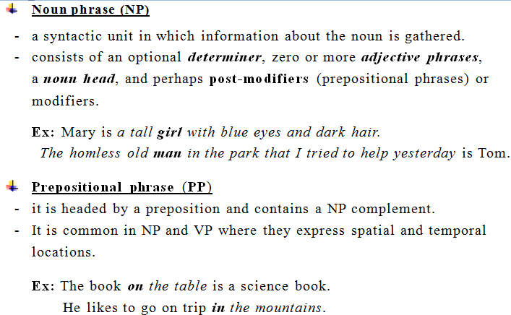
CONSTITUENTS - PHRASES

Slide 4
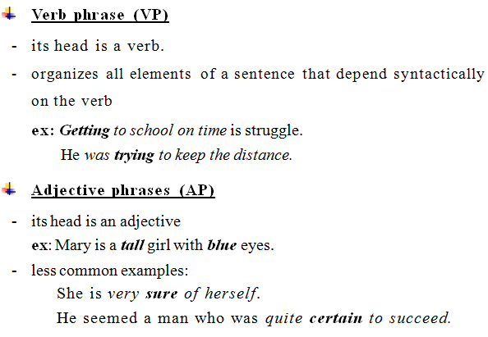
CONSTITUENTS - PHRASES

Slide 5
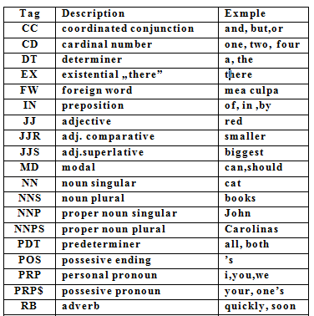
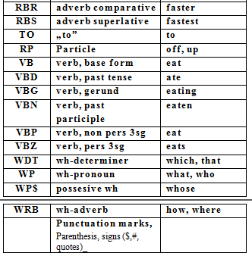

Slide 6
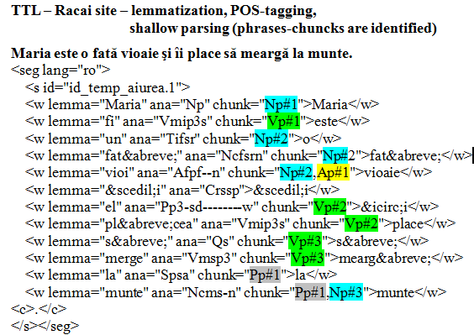
ROMANIAN – PHRASES – SHALLOW PARSING

Slide 7
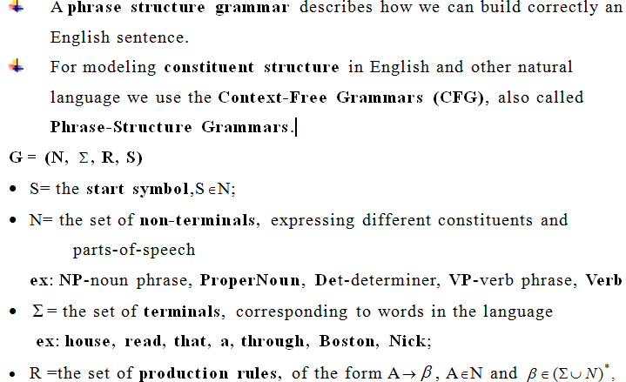
PHRASE STRUCTURE GRAMMAR (PSG)

Slide 8
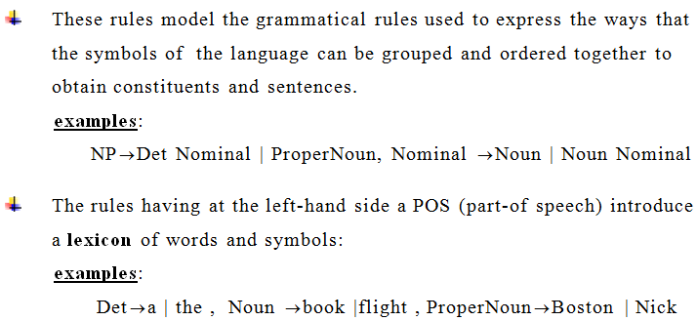
PRODUCTION RULES

Slide 9
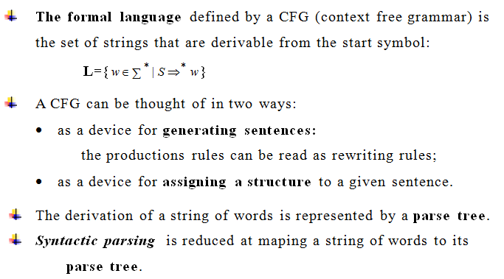

Slide 10
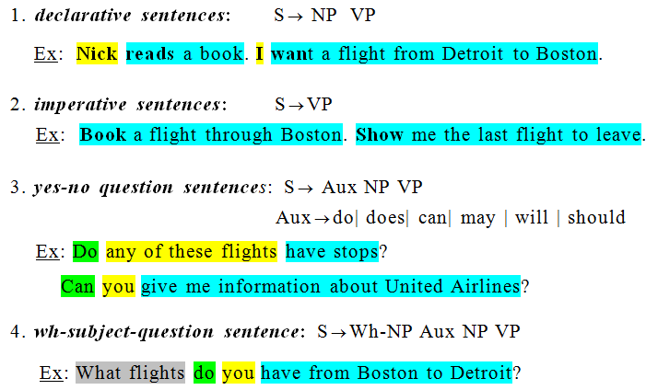
GRAMMAR RULES FOR ENGLISH
- SENTENCE LEVEL CONSTRUCTION

Slide 11
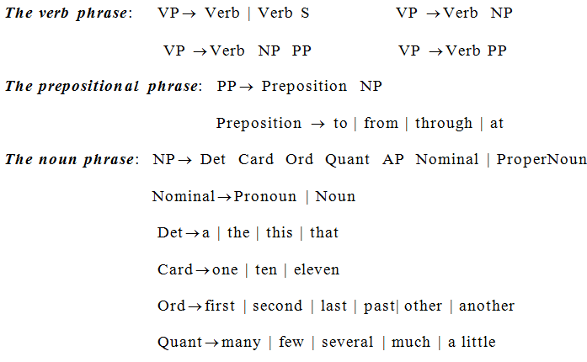
RULES FOR PHRASES

Slide 12
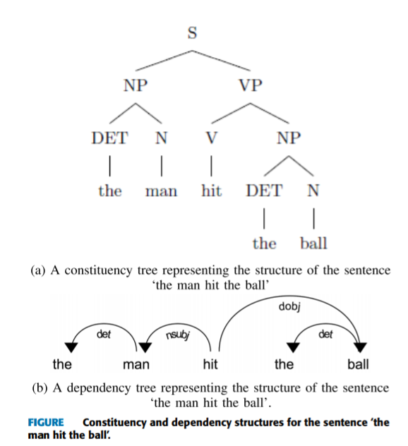
EXAMPLE

Slide 13
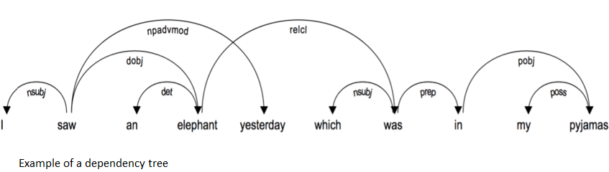
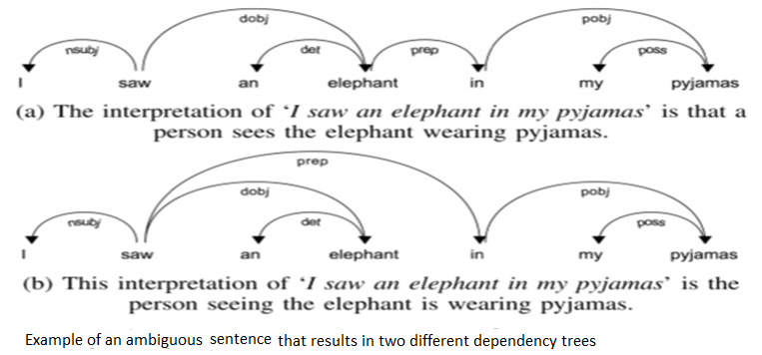
EXAMPLES

Slide 14
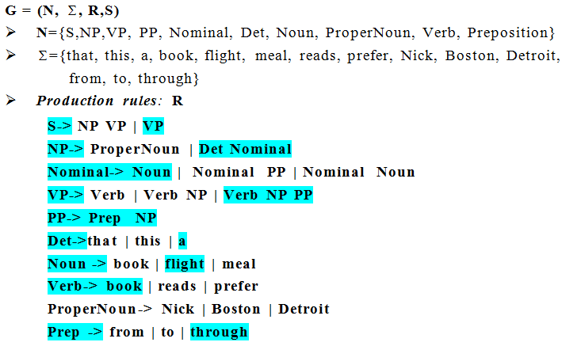
PSG IN ATIS (AIR TRAFFIC INTERNATIONAL SYSTEM)

Slide 15
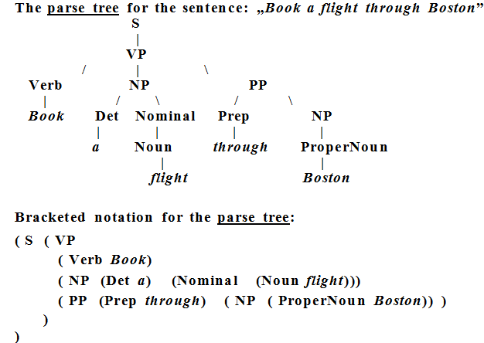
SYNTACTIC PARSING

Slide 16
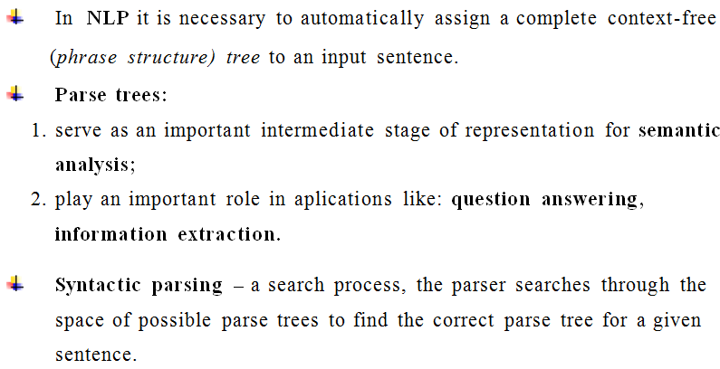
SYNTACTIC PARSING IN NLP

Slide 17
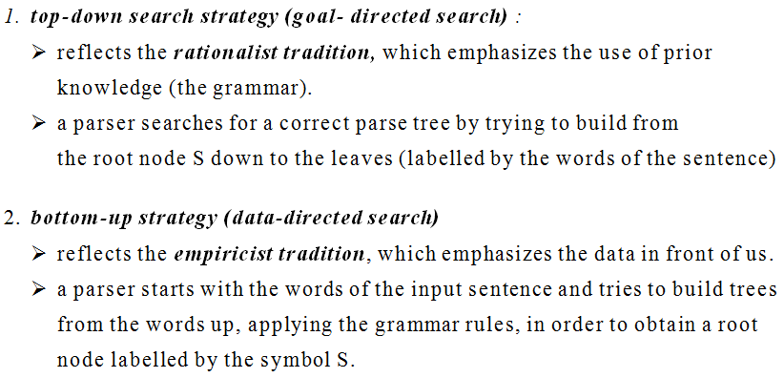
SYNTACTIC PARSING - STRATEGIES

Slide 18
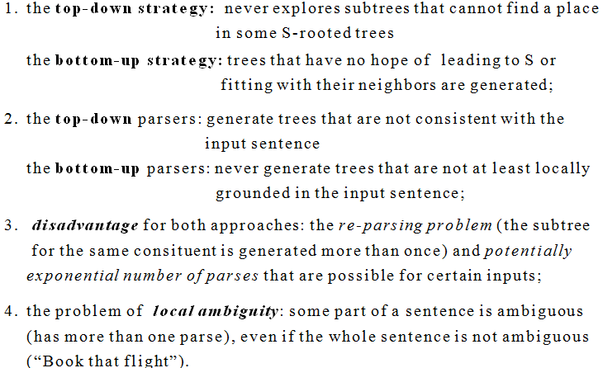
TOP-DOWN VERSUS BOTTOM-UP PARSING

Slide 19
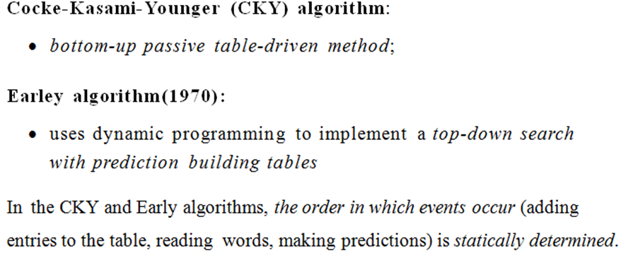
PARSING ALGORITHMS

Slide 20
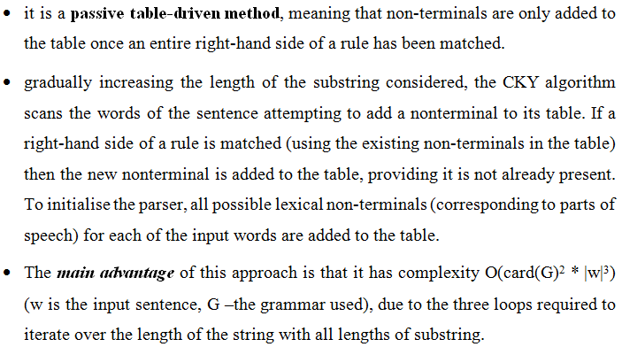
COCKE-KASAMI-YOUNGER (CKY) ALGORITHM

Slide 21
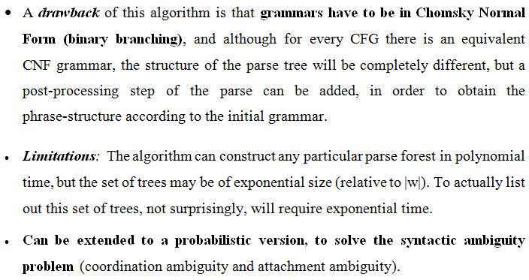
CKY ALGORITHM (CONTD.)

Slide 22
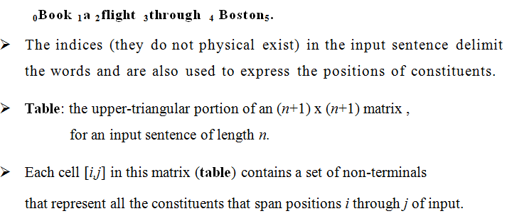
CKY ALGORITHM - INTERNAL DATA STRUCTURE

Slide 23
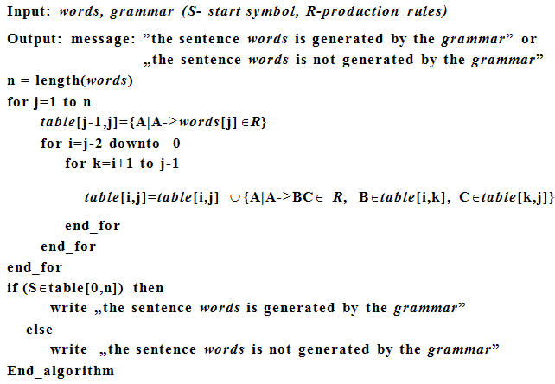
COCKE-KASAMI-YOUNGER (CKY) ALGORITHM

Slide 24
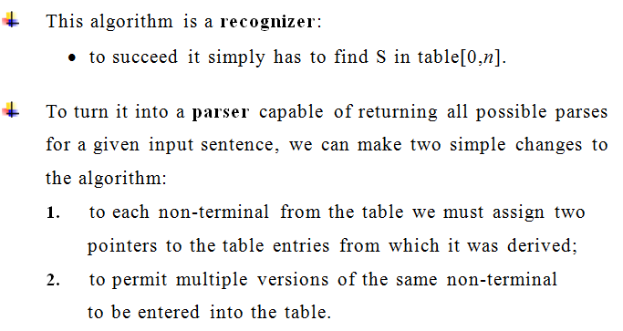
CKY ALGORITHM (CONTD.)

Slide 25
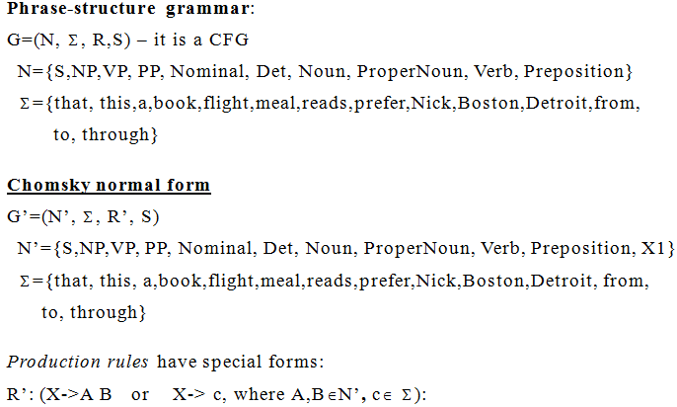
EXAMPLE 1

Slide 26
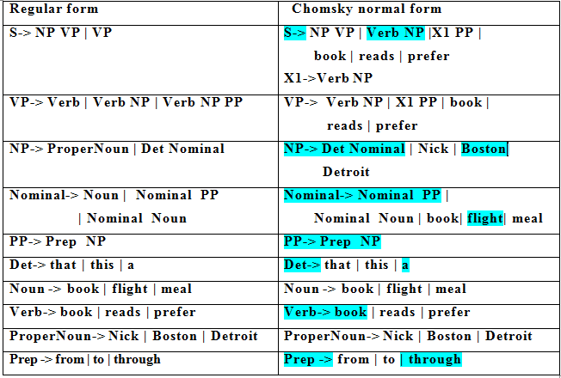

Slide 27
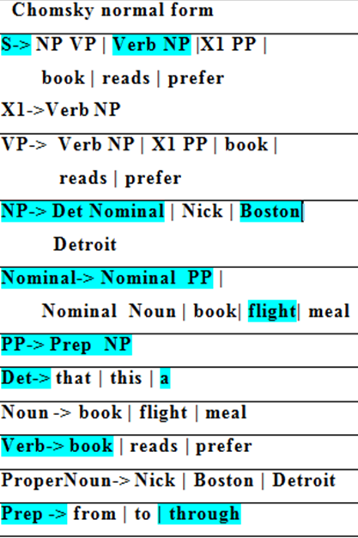
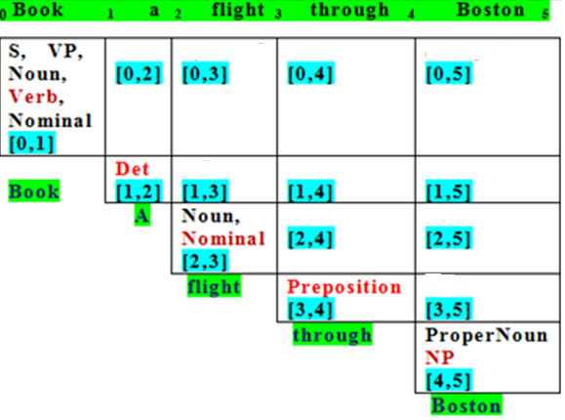
CKY PARSE TABLE FOR THE SENTENCE
BOOK A FLIGHT THROUGH BOSTON.

Slide 28
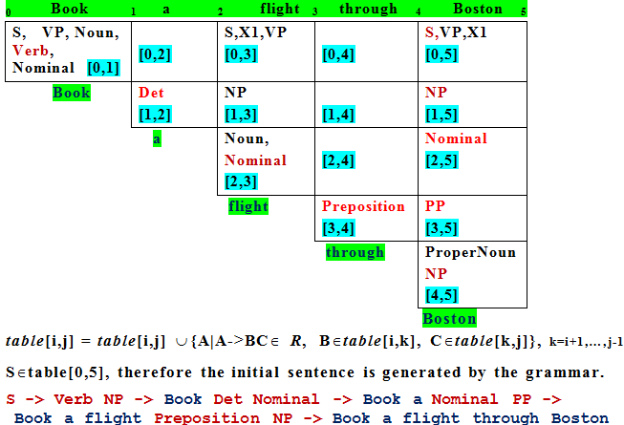
CKY PARSE TABLE FOR THE SENTENCE:
BOOK A FLIGHT THROUGH BOSTON.

Slide 29
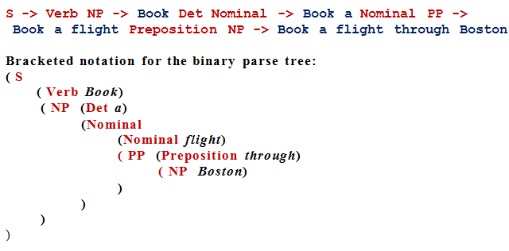
DERIVATION OF THE SENTENCE AND THE PARSE TREE

